Slide 1
On a simple paging system with 2²⁴ bytes of physical memory, 256 pages of logical address space and a page size of 2¹⁰ bytes, how many bytes in the physical address specify the page frame?
On a simple paging system with a page table containing 64 entries of 11 bits each (including valid/invalid bit), and a page size of 512 bytes, what is the size of logical address space?

Slide 2
Memory Management, Early Systems
Single-User Contiguous Scheme
Fixed Partitions
Dynamic Partitions
Deallocation
Relocatable Dynamic Partitions
Conclusion
Single User Configurations
Fixed Partitions
Dynamic Partitions
Relocatable Dynamic Partitions

Slide 3
Single-User Contiguous Scheme
Each program loaded in its entirety into memory and allocated as much contiguous memory space as needed.
If program was too large -- it couldn’t be executed.
Minimal amount of work done by Memory Manager.
Hardware needed : 1) register to store base address; 2) accumulator to track size of program as it is loaded into memory.

Slide 4
Algorithm to Load a Job in a Single-user System
1. Store first memory location of program into base register
2. Set program counter equal to address of first memory location
3. Load instructions of program
4. Increment program counter by number of bytes in instructions
5. Has the last instruction been reached?
If yes, then stop loading program
If no, then continue with step 6
6. Is program counter greater than memory size?
If yes, then stop loading.
If no, then continue with step 7
7. Load instruction in memory
8. Go to step 3.

Slide 5
Fixed (Static) Partitions
Attempt at multiprogramming using fixed partitions
  one partition for each job
  size of partition designated by reconfiguring the system
  partitions can’t be too small or too large.
Critical to protect job’s memory space.
Entire program stored contiguously in memory during entire execution.
Internal fragmentation is a problem.

Slide 6
Algorithm to Load a Job in a
Fixed Partition
1. Determine job’s requested memory size
2. If job_size > size of largest partition then reject job
Print appropriate message
Go to step 1 to handle next job
Else continue with step 3
3. Set counter to 1
4. Do while counter <= number of partitions in memory
If job_size > mem_partition_size (counter)
then counter = counter + 1
Else
If mem_partition_status (counter) = “free”
then load job into mem_partition(counter)
change mem_partition_status(counter) to “busy”
go to step 1
Else counter = counter + 1
End do
5. No partition available at this time, put job in waiting queue
6. Go to step 1

Slide 7
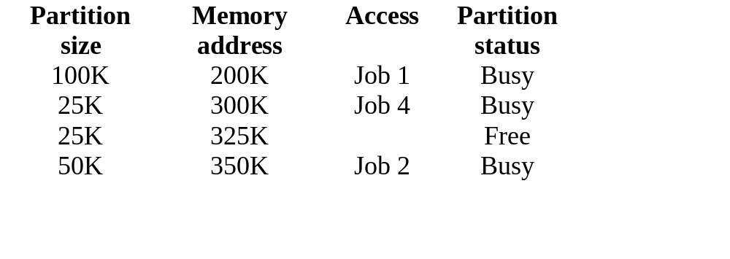
Simplified Fixed Partition
Memory Table

Slide 8
Table 2.1 : Main memory use during fixed partition allocation of Table 2.1. Job 3 must wait.
Job List :
J1 30K
J2 50K
J3 30K
J4 25K
Original State
After Job Entry
100K
Job 1 (30K)
Partition 1
Partition 1
Partition 2
25K
Job 4 (25K)
Partition 2
Partition 3
25K
Partition 3
50K
Job 2 (50K)
Partition 4
Partition 4

Slide 9
Dynamic Partitions
Available memory kept in contiguous blocks and jobs given only as much memory as they request when loaded.
Improves memory use over fixed partitions.
Performance deteriorates as new jobs enter the system
  fragments of free memory are created between blocks of allocated memory (external fragmentation).

Slide 10
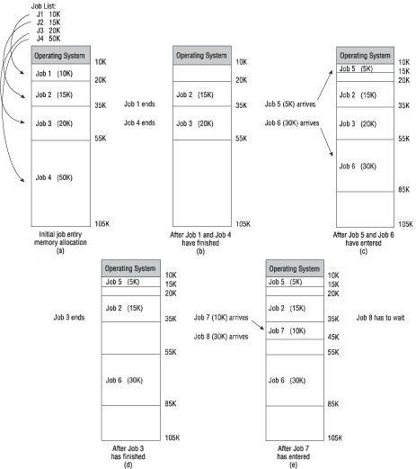
Dynamic Partitioning of Main Memory & Fragmentation

Slide 11
Dynamic Partition Allocation Schemes
First-fit: Allocate the first partition that is big enough.
  Keep free/busy lists organized by memory location (low-order to high-order).
  Faster in making the allocation.
Best-fit: Allocate the smallest partition that is big enough
  Keep free/busy lists ordered by size (smallest to largest).
  Produces the smallest leftover partition.
  Makes best use of memory.

Slide 12
First-Fit Allocation Example
J1 10K
J2 20K
J3 30K*
J4 10K
Memory Job Job Internal
location block size number size Status fragmentation
10240 30K J1 10K Busy 20K
40960 15K J4 10K Busy 5K
56320 50K J2 20K Busy 30K
107520 20K Free
Total Available: 115K Total Used: 40K
Job List

Slide 13
Best-Fit Allocation Example
J1 10K
J2 20K
J3 30K
J4 10K
Memory Memory Job Job Internal
location block size number size Status fragmentation
40960 15K J1 10K Busy 5K
107520 20K J2 20K Busy None
10240 30K J3 30K Busy None
56230 50K J4 10K Busy 40K
Total Available: 115K Total Used: 70K
Job List

Slide 14
First-Fit Algorithm
1. Set counter to 1
2. Do while counter <= number of blocks in memory
If job_size > memory_size(counter)
then counter = counter + 1
else
load job into memory_size(counter)
adjust free/busy memory lists
go to step 4
End do
3. Put job in waiting queue
4. Go fetch next job

Slide 15
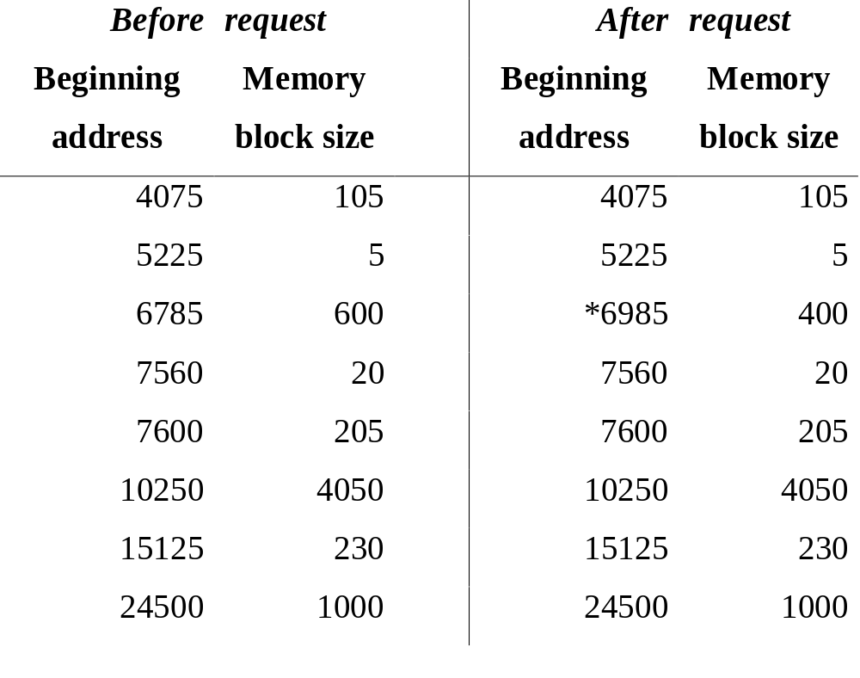
First-Fit Memory Request

Slide 16
Best-Fit Algorithm
1. Initialize mem_block(0) = 99999
2. Compute initial_mem_waste = memory_block(0) – job_size
3. Initialize subscript = 0
4. Set counter to 1
5. Do while counter <= number of blocks in memory
If job_size > mem_size(counter)
Then counter = counter + 1 Else
mem_waste = mem_size(counter) – job_size
If initial_mem_waste > mem_waste
Then subscript = counter
initial_mem_waste = mem_waste
counter = counter + 1
End do
6. If subscript = 0
Then put job in waiting queue
Else
load job into mem_size(subscript)
adjust free/busy memory lists
7. Go fetch next job

Slide 17

Best-Fit Memory Request

Slide 18
Best-Fit vs. First-Fit
First-Fit
Increases memory use
Memory allocation takes less time
Reduces internal fragmentation
Best-Fit
More complex algorithm
Searches entire table before allocating memory
Results in a smaller “free” space (sliver)

Slide 19
Dynamic Partitioning
Next-fit
  Scans memory from the location of the last placement
  More often allocate a block of memory at the end of memory where the largest block is found
  The largest block of memory is broken up into smaller blocks
  Compaction is required to obtain a large block at the end of memory

Slide 20
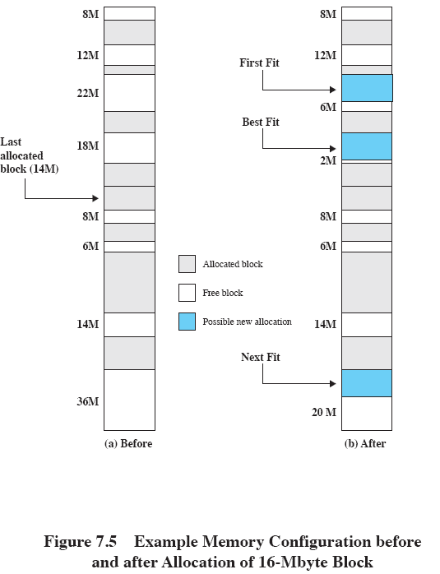
Allocation
Notes:
Slide shows Fig 7.5 - an example memory configuration after a number of placement and swapping-out operations.
The last block that was used was a 22-Mbyte block from which a 14-Mbyte partition was created.
Figure 7.5b shows the difference between the best, first, and next-fit placement algorithms in satisfying a 16-Mbyte allocation request.
Best-fit will search the entire list of available blocks and make use of the 18-Mbyte block, leaving a 2-Mbyte fragment.
First-fit results in a 6-Mbyte fragment, and
Next-fit results in a 20-Mbyte fragment.

Slide 21
Release of Memory Space : Deallocation
Deallocation for fixed partitions is simple
  Memory Manager resets status of memory block to “free”.
Deallocation for dynamic partitions tries to combine free areas of memory whenever possible
  Is the block adjacent to another free block?
  Is the block between 2 free blocks?
  Is the block isolated from other free blocks?

Slide 22
Algorithm to Deallocate
Memory Blocks
If job_location is adjacent to 1+ free blocks
Then
If job_location is between 2 free blocks
Then merge all 3 blocks into 1 block
mem_size(counter-1) = mem_size(counter-1) + job_size
+ mem_size(counter+1)
Set status of mem_size(counter+1) to null entry
Else
merge both blocks into one
mem_size(counter-1) = mem_size(counter-1) + job_size
Else
search for null entry in free memory list
enter job_size and beginning_address in entry slot
set its status to “free”

Slide 23
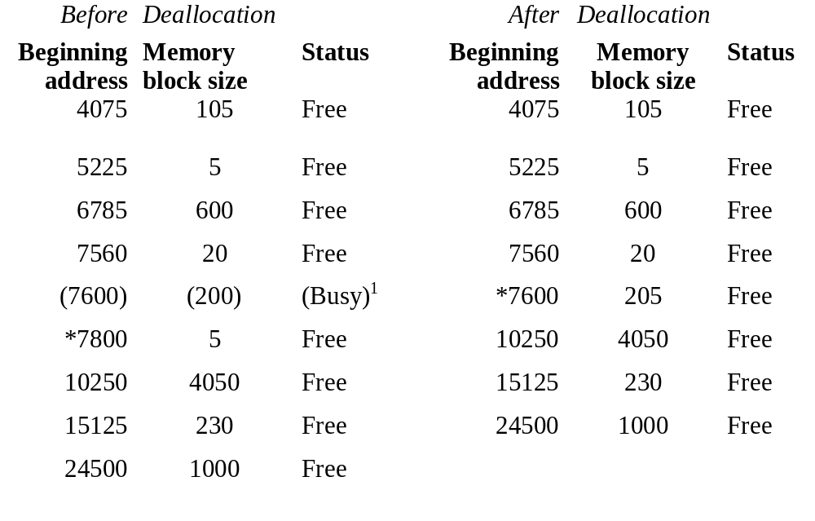
Case 1: Joining 2 Free Blocks

Slide 24
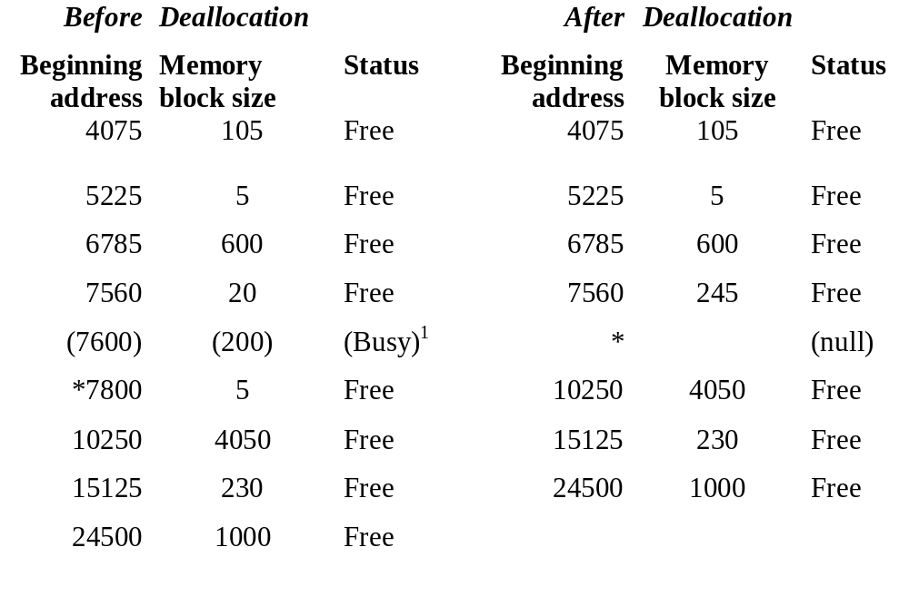
Case 2: Joining 3 Free Blocks

Slide 25
Relocatable Dynamic Partitions
Memory Manager relocates programs to gather all empty blocks and compact them to make 1 memory block.
Memory compaction (garbage collection, defragmentation) performed by OS to reclaim fragmented sections of memory space.
Memory Manager optimizes use of memory & improves throughput by compacting & relocating.

Slide 26
Compaction Steps
Relocate every program in memory so they’re contiguous.
Adjust every address, and every reference to an address, within each program to account for program’s new location in memory.
Must leave alone all other values within the program (e.g., data values).

Slide 27
Program in Memory During Compaction & Relocation
Free list & busy list are updated
  free list shows partition for new block of free memory
  busy list shows new locations for all relocated jobs
Bounds register stores highest location in memory accessible by each program.
Relocation register contains value that must be added to each address referenced in program so it can access correct memory addresses after relocation.

Slide 28
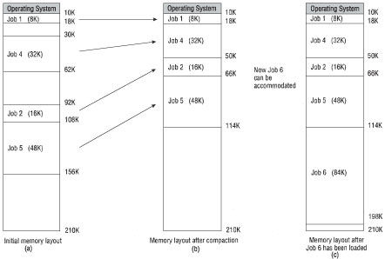
Memory Before & After Compaction

Slide 29
More Overhead is a Problem with Compaction & Relocation
Timing of compaction (when, how often) is crucial.
Approaches to timing of compaction:
  1. Compact when certain percentage of memory is busy (e.g., 75%).
  2. Compact only when jobs are waiting.
  3. Compact after certain amount of time.

Slide 30
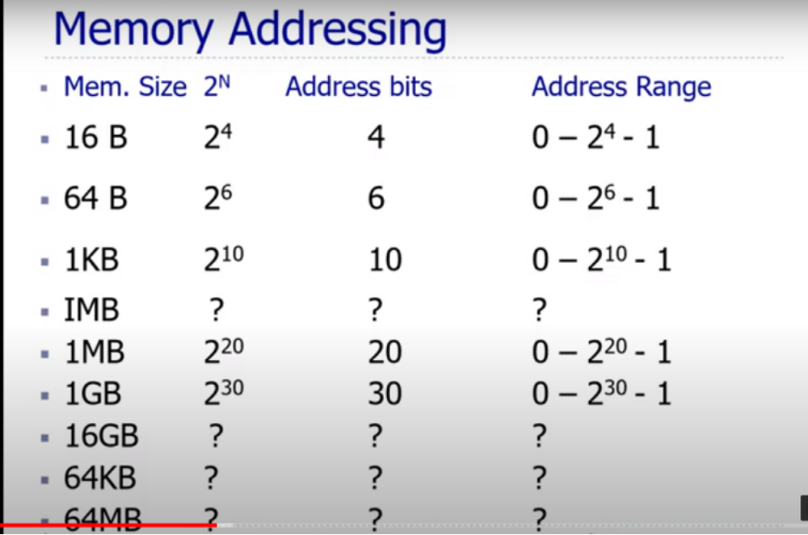


Slide 31
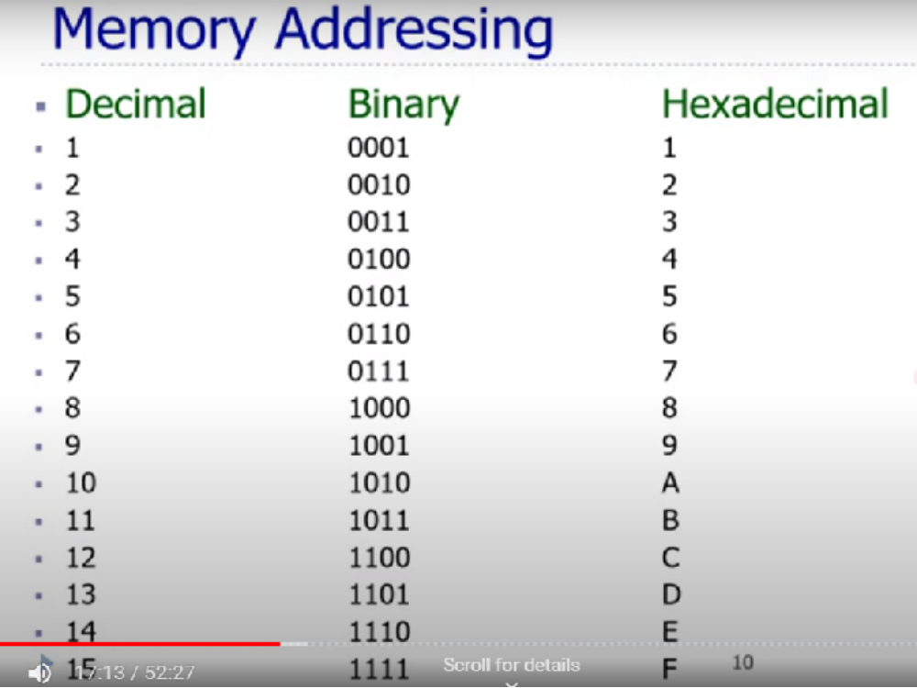

Slide 32
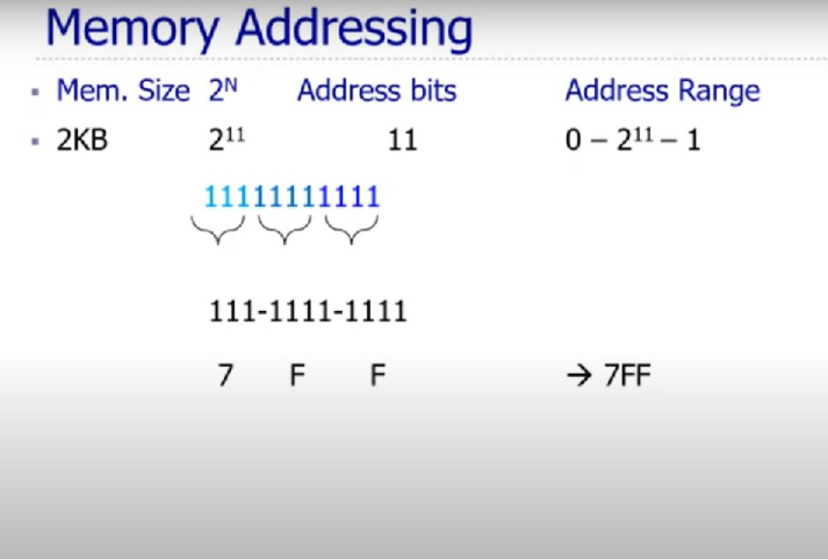

Slide 33
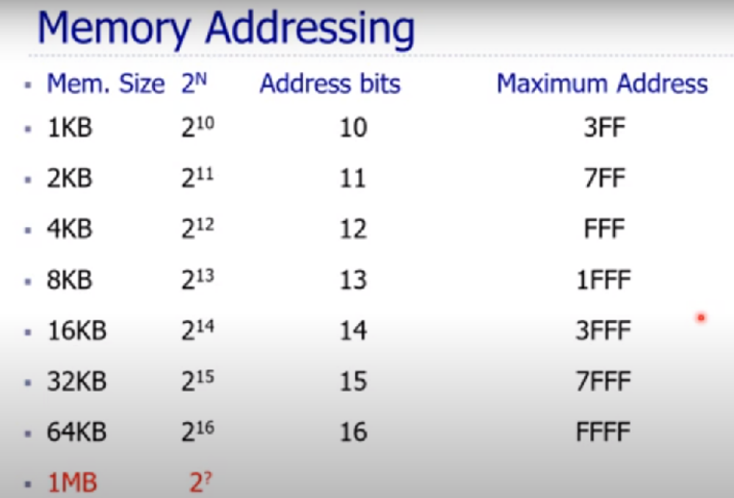

Slide 34
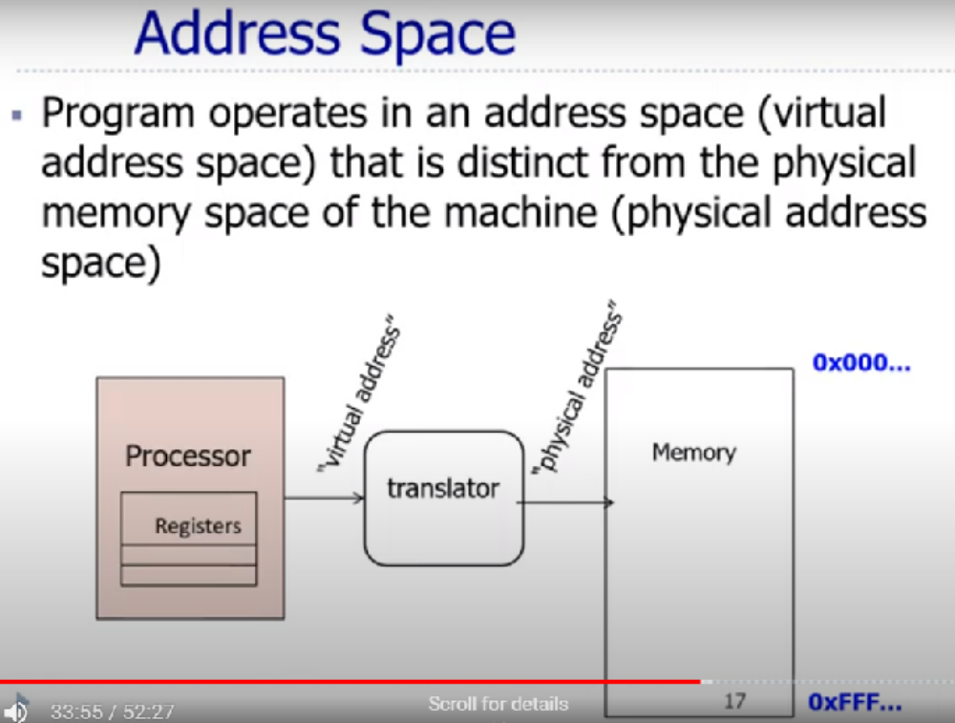

Slide 35
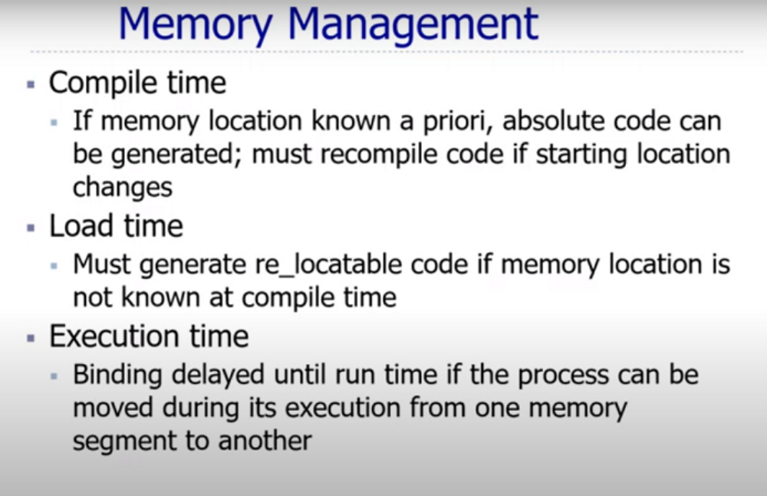

Slide 36
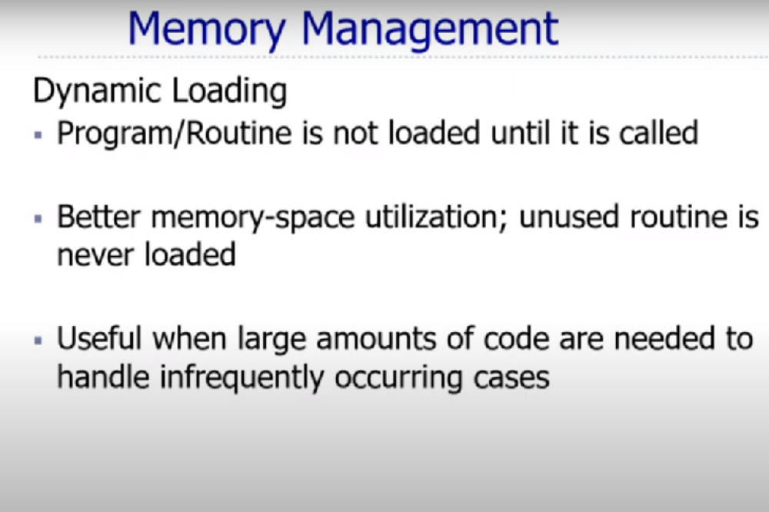

Slide 37
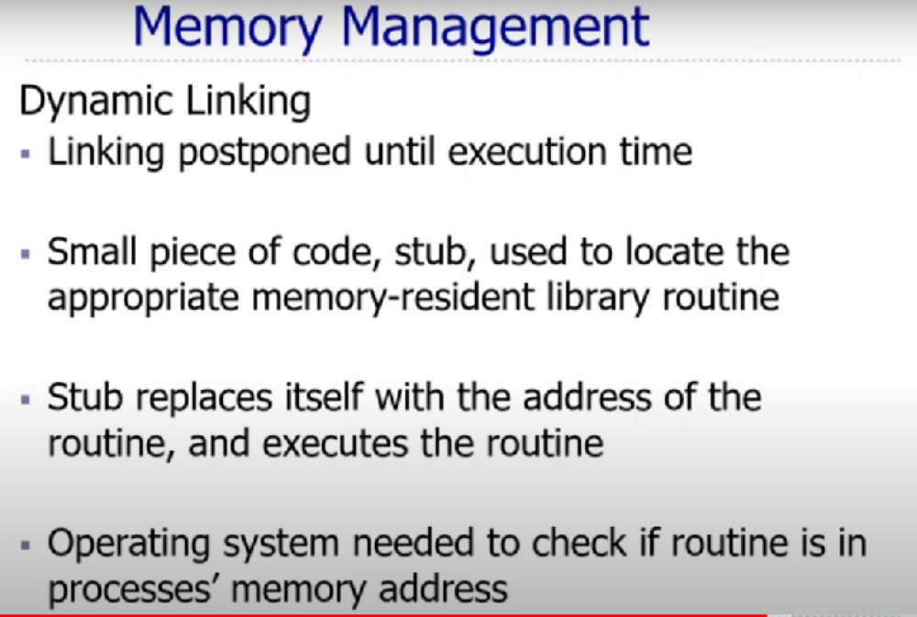

Slide 38
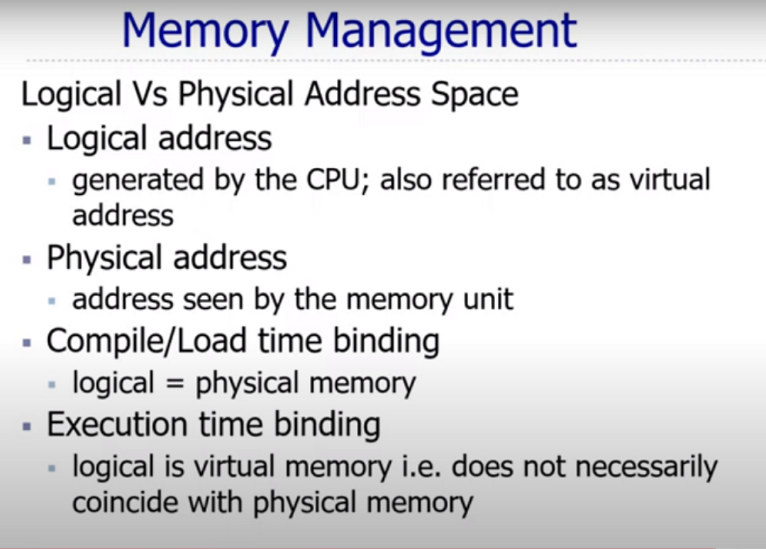

Slide 39
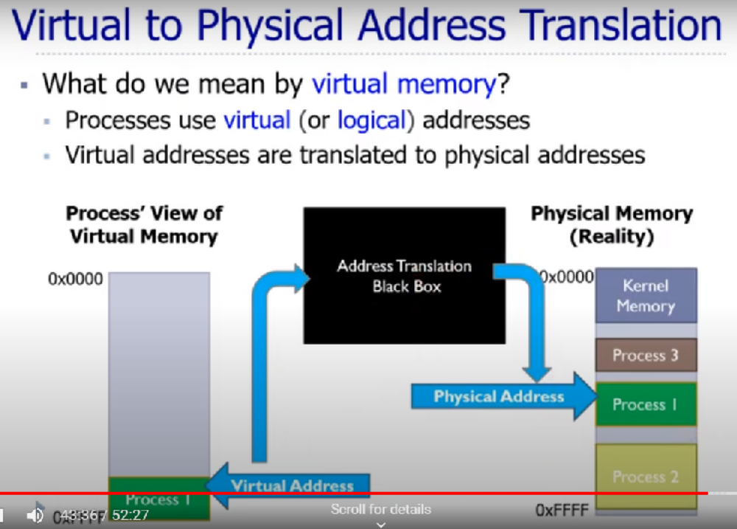

Slide 40
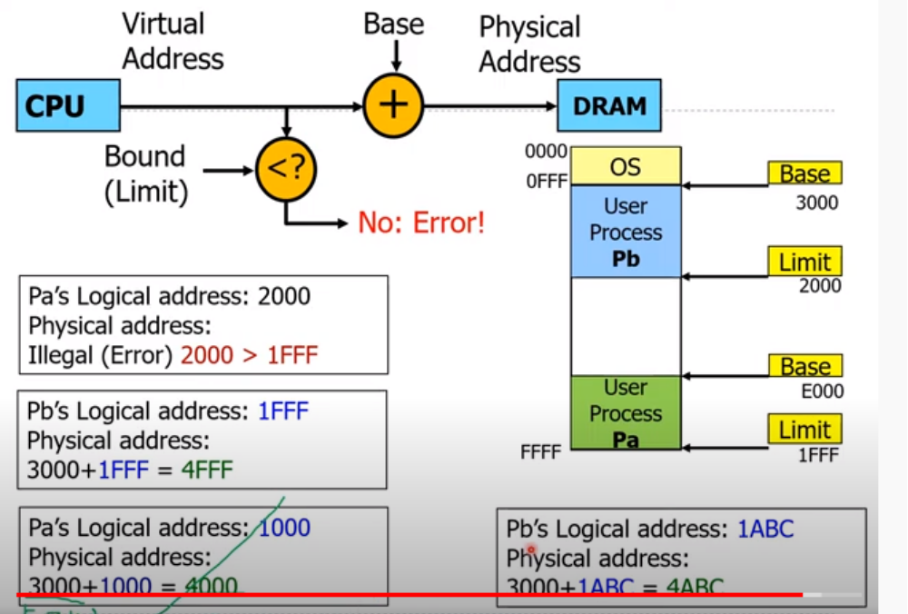

Slide 41
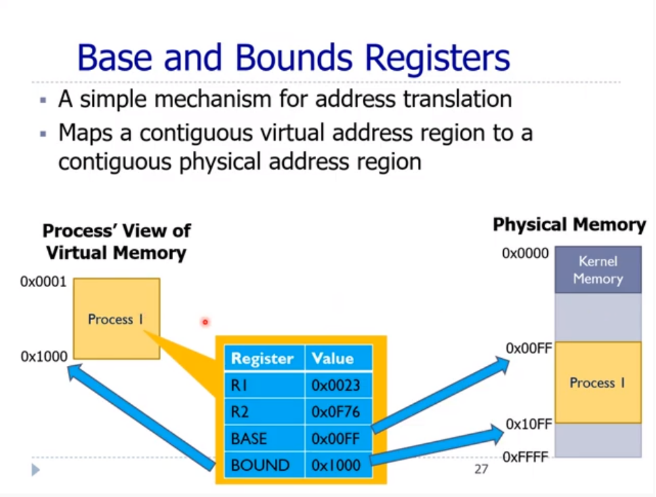

Slide 42
Buddy System
Entire space available is treated as a single block of 2^{U}
If a request of size s where 2^{U-1} < s <= 2^{U}
  entire block is allocated
Otherwise block is split into two equal buddies
  Process continues until smallest block greater than or equal to s is generated
Notes:
In a fixed partitioning scheme limits the number of active processes and may use space inefficiently if there is a poor match between available partition sizes and process sizes.
A dynamic partitioning scheme is more complex to maintain and includes the overhead of compaction.
An interesting compromise is the buddy system.

Slide 43
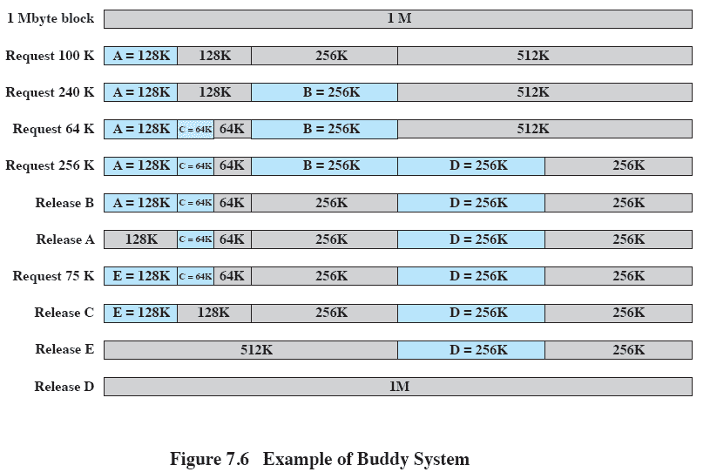
Example of Buddy System
Notes:
Figure 7.6 gives an example using a 1-Mbyte initial block.
The first request,A, is for 100 Kbytes, for which a 128K block is needed.
The initial block is divided into two 512K buddies.
The first of these is divided into two 256K buddies,
and the first of these is divided into two 128K buddies,
one of which is allocated to A.
The next request,B, requires a 256K block. Such a block is already available and is allocated.
The process continues with splitting and coalescing occurring as needed.
Note that when E is released,two 128K buddies are coalesced into a 256K block, which is immediately coalesced with its buddy

Slide 44
Task1 (memory management)
Assume a computer with a memory size of 256K, initially empty. Requests are received for blocks of memory of 5K, 25K, 35K and 20K. Show how the buddy system would deal with each request, showing the memory layout at each stage and the status of the lists at the end.
After allocating all the processes, what would be the effect of the 25K process terminating and returning its memory? After that, find the total internal and external fragmentation

Slide 45

Task2(memory management)
Consider a swapping system in which memory consists of 540K as shown below:
Where xxx.. Indicates the unused memory.
Note P3, P5, and P7 are processes in memory. Assume that process P3 was just swapped into memory and that new processes arrive in the order P8, P9, P10, P11 and are of size 70K, 50K, and 80K, 40K respectively. How would each of the first-fit, next-fit, best-fit, and worst-fit algorithms place processes of P8, P9, P10, and P11? If a process won’t fit, write ’out of memory’ in the appropriate slot.

Slide 46
Logical vs. Physical Address Space
The concept of a logical address space that is bound to a separate physical address space is central to proper memory management.
  Logical address – generated by the CPU; also referred to as virtual address.
  Physical address – address seen by the memory unit.

Slide 47
Memory-Management Unit (MMU)
Hardware device that maps virtual address to physical address.
In MMU scheme, the value in the relocation register is added to every address generated by a user process at the time it is sent to memory.
The user program deals with logical addresses; it never sees the real physical addresses.

Slide 48

Dynamic relocation using a relocation register

Slide 49
Swapping
A process can be swapped temporarily out of memory to a backing store, and then brought back into memory for continued execution.
Backing store – fast disk large enough to accommodate copies of all memory images for all users; must provide direct access to these memory images.
Roll out, roll in – swapping variant used for priority-based scheduling algorithms; lower-priority process is swapped out so higher-priority process can be loaded and executed.
Major part of swap time is transfer time; total transfer time is directly proportional to the amount of memory swapped.

Slide 50

Schematic View of Swapping

Slide 51
Paging
Logical address space of a process can be noncontiguous; process is allocated physical memory whenever the latter is available.
Divide physical memory into fixed-sized blocks called frames (size is power of 2, between 512 bytes and 8192 bytes).
Divide logical memory into blocks of same size called pages.
Keep track of all free frames.
To run a program of size n pages, need to find n free frames .
Set up a page table to translate logical to physical addresses.
Internal fragmentation.

Slide 52
Address Translation Scheme
Address generated by CPU is divided into:
  Page number (p) – used as an index into a page table which contains base address of each page in physical memory.
  Page offset/displacement (d) – combined with base address to define the physical memory address that is sent to the memory unit.

Slide 53
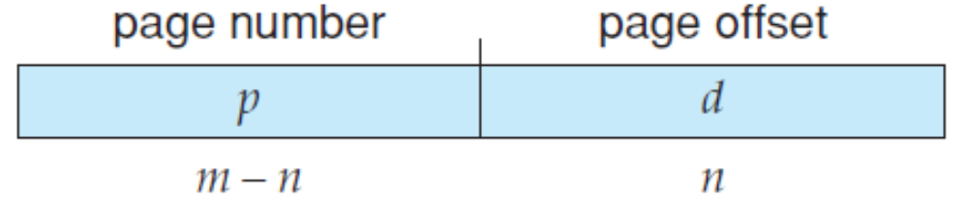
If the size of the logical address space is 2^{m}, and a page size is 2^{n} bytes, then the high-order m− n bits of a logical address designate the page number, and the n low-order bits designate the page offset.

Slide 54

Address Translation Architecture

Slide 55

Paging Example

Slide 56

Paging Example

Slide 57

Hardware Support for Relocation and Limit Registers

Slide 58

Free Frames
Before allocation
After allocation

Slide 59
Implementation of Page Table
Page table is kept in main memory.
Page-table base register (PTBR) points to the page table.
Page-table length register (PRLR) indicates size of the page table.
In this scheme every data/instruction access requires two memory accesses. One for the page table and one for the data/instruction.
The two memory access problem can be solved by the use of a special fast-lookup hardware cache called associative memory or translation look-aside buffers (TLBs)

Slide 60
Associative Memory
Associative memory – parallel search
Address translation (A´, A´´)
  If A´ is in associative register, get frame # out.
  Otherwise get frame # from page table in memory
Page #
Frame #

Slide 61

Paging Hardware With TLB

Slide 62
Memory Protection
Memory protection implemented by associating protection bit with each frame.
Valid-invalid bit attached to each entry in the page table:
  “valid” indicates that the associated page is in the process’ logical address space, and is thus a legal page.
  “invalid” indicates that the page is not in the process’ logical address space.

Slide 63

Valid (v) or Invalid (i) Bit In A Page Table

Slide 64
Shared Pages
Shared code
  One copy of read-only (reentrant) code shared among processes (i.e., text editors, compilers, window systems).
  Shared code must appear in same location in the logical address space of all processes.
Private code and data
  Each process keeps a separate copy of the code and data.
  The pages for the private code and data can appear anywhere in the logical address space.

Slide 65

Shared Pages Example

Slide 66
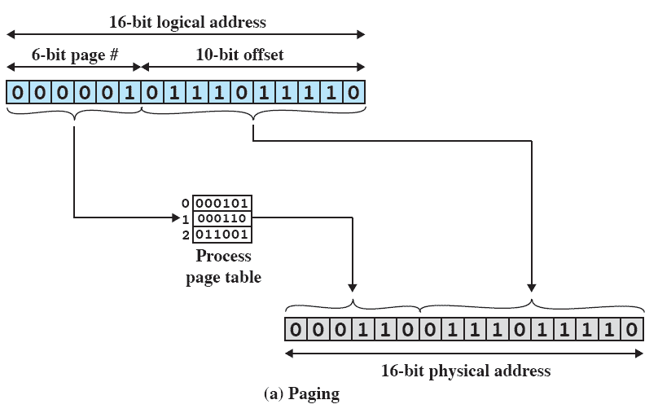
Paging
Notes:
In our example, we have the logical address 0000010111011110,
which is page number 1, offset 478.
Suppose that this page is residing in main memory frame 6 = binary 000110.
Then the physical address is frame number 6, offset 478 = 0001100111011110

Slide 67
Paging
Physical memory is divided into fixed-size blocks called frames.
The logical memory of the programs is broken into fixed-size blocks called pages.
The system keeps a list of frames that are not currently being used, called the free frame list.
Initially, all frames are free.
The page size = frame size is always a power of 2.

Slide 68
Paging
A logical address generated by the CPU is divided into a page number (p) and a page offset (d).
total bits: p + d
--------------------------------------------------
| page number: p bits |offset: d bits| ---------------------------------------------------
If the offset has d bits, the page size is 2^{d}.
If the page number has p bits, the number of pages is 2^{p}.
The maximum size of a process is 2^{p+d} bytes.

Slide 69
Paging
The physical address used by the memory system is divided into a frame number and an offset.
total bits: f + d
-----------------------------------------------------
| frame number: f bits |offset: d bits|
-----------------------------------------------------
If the frame number has f bits, the number of frames is 2^{f}.
The total amount of physical memory supported by the system is 2^{f+d} bytes.

Slide 70
Segmentation
Memory-management scheme that supports user view of memory.
A program is a collection of segments. A segment is a logical unit such as:
main program,
procedure,
function,
method,
object,
local variables, global variables,
common block,
stack,
symbol table, arrays

Slide 71

User’s View of a Program

Slide 72
Logical View of Segmentation
1
1
4
2
3
2
4
3
user space
physical memory space

Slide 73
Segmentation Architecture
Logical address consists of a two tuple:
<segment-number, offset>,
Segment table – maps two-dimensional physical addresses; each table entry has:
  base – contains the starting physical address where the segments reside in memory.
  limit – specifies the length of the segment.
Segment-table base register (STBR) points to the segment table’s location in memory.
Segment-table length register (STLR) indicates number of segments used by a program;
segment number s is legal if s < STLR.

Slide 74

Segmentation Hardware

Slide 75

Example of Segmentation

Slide 76

Sharing of Segments

Slide 77
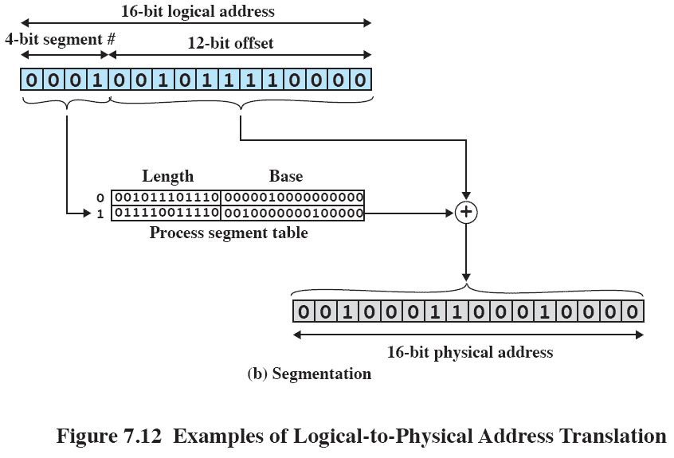
Segmentation
Notes:
In our example, we have the logical address 0001001011110000, which is segment number 1, offset 752.
Suppose that this segment is residing in main memory starting at physical address 0010000000100000.
Then the physical address is 0010000000100000 + 001011110000 = 0010001100010000

Slide 78
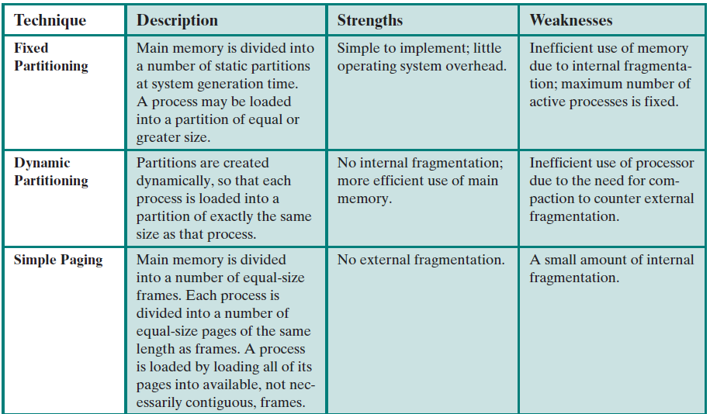

Slide 79
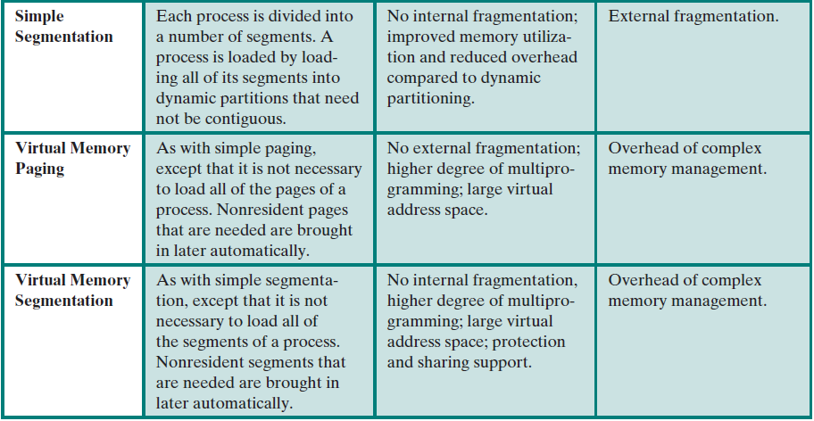

Slide 80
Virtual Memory
Background
Demand Paging
Page Replacement
Allocation of Frames
Thrashing

Slide 81
Background
Virtual memory – separation of user logical memory from physical memory.
  Only part of the program needs to be in memory for execution.
  Logical address space can therefore be much larger than physical address space.
  Allows address spaces to be shared by several processes.
  Allows for more efficient process creation.
Virtual memory can be implemented via:
  Demand paging
  Demand segmentation

Slide 82
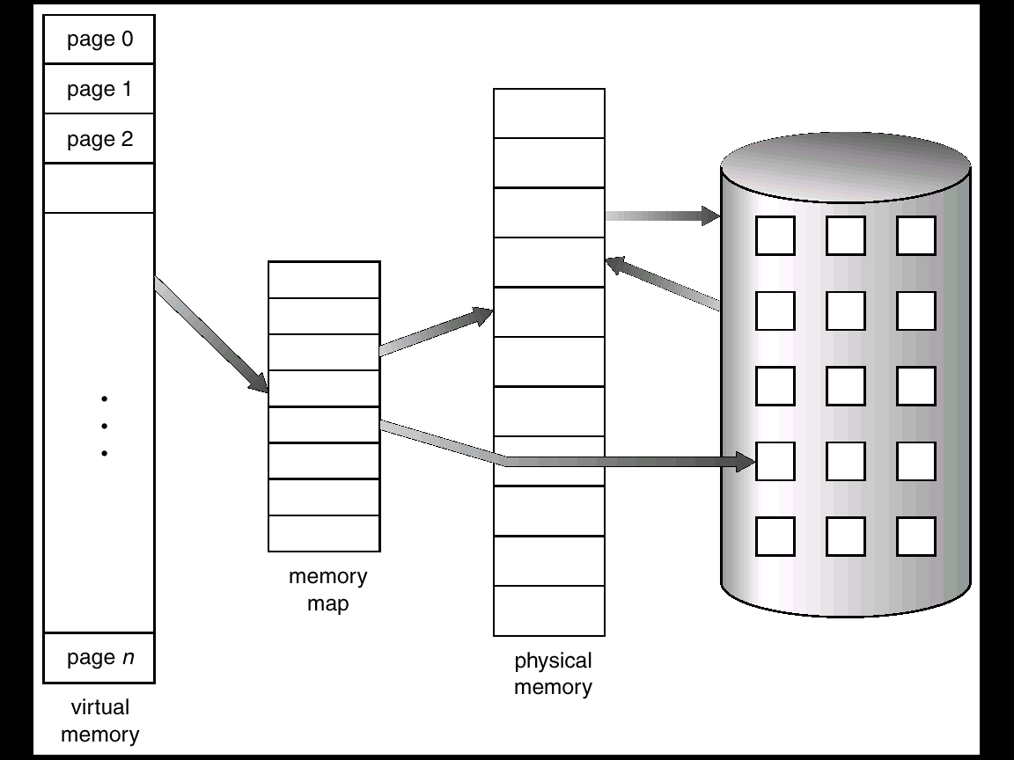
Virtual Memory That is Larger Than Physical Memory

Slide 83
Demand Paging
Bring a page into memory only when it is needed.
  Less I/O needed
  Less memory needed
Page is needed ⇒ reference to it
  invalid reference ⇒ abort
  not-in-memory ⇒ bring to memory

Slide 84
Valid-Invalid Bit
With each page table entry a valid–invalid bit is associated
(1 ⇒ in-memory, 0 ⇒ not-in-memory)
Initially valid–invalid bit is set to 0 on all entries.
Example of a page table snapshot.
During address translation, if valid–invalid bit in page table entry is 0 ⇒ page fault.
Frame #
valid-invalid bit
1
1
1
1
0

0
0
page table

Slide 85

Page Table When Some Pages Are Not in Main Memory

Slide 86
Page Fault
If there is ever a reference to a page, first reference will trap to
OS ⇒ page fault
OS looks at another table to decide:
  Invalid reference ⇒ abort.
  Just not in memory.
Get empty frame.
Swap page into frame.
Reset tables, validation bit = 1.
Restart instruction:

Slide 87
Steps in Handling a Page Fault
1. We check an internal table for this process to determine whether the reference was a valid or an invalid memory access.
2. If the reference was invalid, we terminate the process. If it was valid, but we have not yet brought in that page, we now page it in.
3. We find a free frame (by taking one from the free-frame list, for example).
4. We schedule a disk operation to read the desired page into the newly allocated frame.
5. When the disk read is complete, we modify the internal table kept with the process and the page table to indicate that the page is now in memory.
6. We restart the instruction that was interrupted by the trap. The process can now access the page as though it had always been in memory.

Slide 88

Steps in Handling a Page Fault

Slide 89
What happens if there is no free frame?
Page replacement – find some page in memory, but not really in use, swap it out.
  algorithm
  performance – want an algorithm which will result in minimum number of page faults.
Same page may be brought into memory several times.

Slide 90
Page Replacement
Prevent over-allocation of memory by modifying page-fault service routine to include page replacement.
Use modify (dirty) bit to reduce overhead of page transfers – only modified pages are written to disk.

Slide 91
Basic Page Replacement
Find the location of the desired page on disk.
Find a free frame:
- If there is a free frame, use it.
- If there is no free frame, use a page replacement algorithm to select a victim frame.
Read the desired page into the (newly) free frame. Update the page and frame tables.
Restart the process.

Slide 92

Page Replacement

Slide 93
Page Replacement Algorithms
Want lowest page-fault rate.
Evaluate algorithm by running it on a particular string of memory references (reference string) and computing the number of page faults on that string.
In all our examples, the reference string is
1, 2, 3, 4, 1, 2, 5, 1, 2, 3, 4, 5.

Slide 94

Graph of Page Faults Versus The Number of Frames

Slide 95
First-In-First-Out (FIFO) Algorithm
Reference string: 1, 2, 3, 4, 1, 2, 5, 1, 2, 3, 4, 5
3 frames (3 pages can be in memory at a time per process)
FIFO Replacement – Belady’s Anomaly
1
1
4
5
2
2
1
3
9 page faults
3
3
2
4
1
1
5
4
2
2
1
5
10 page faults
3
3
2
4
4
3

Slide 96
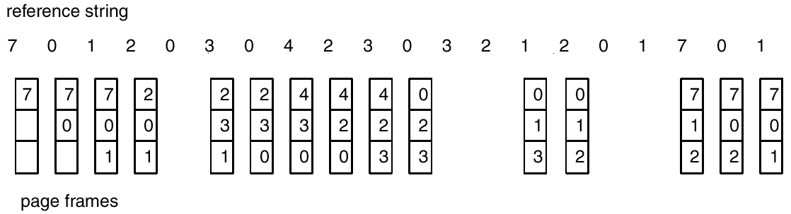
FIFO Page Replacement

Slide 97

FIFO Illustrating Belady’s Anamoly

Slide 98
Optimal Algorithm
Replace page that will not be used for longest period of time.
4 frames example
1, 2, 3, 4, 1, 2, 5, 1, 2, 3, 4, 5
How do you know this?
Used for measuring how well your algorithm performs.

Slide 99
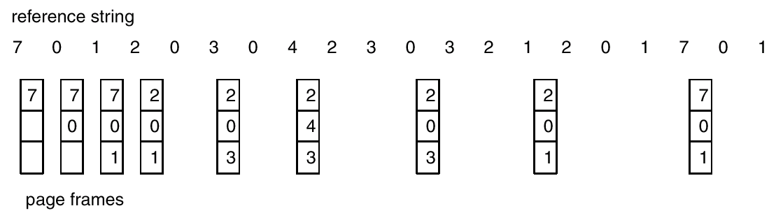
Optimal Page Replacement

Slide 100
Least Recently Used (LRU) Algorithm
  Replaces the page that has not been used for the longest time
Reference string: 1, 2, 3, 4, 1, 2, 5, 1, 2, 3, 4, 5

Slide 101
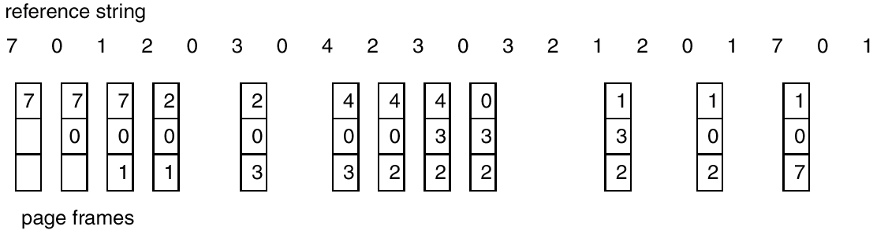
LRU Page Replacement

Slide 102
LRU Algorithm (Cont.)
Stack implementation – keep a stack of page numbers in a double link form:
  Page referenced:
    move it to the top
    requires 6 pointers to be changed
  No search for replacement

Slide 103
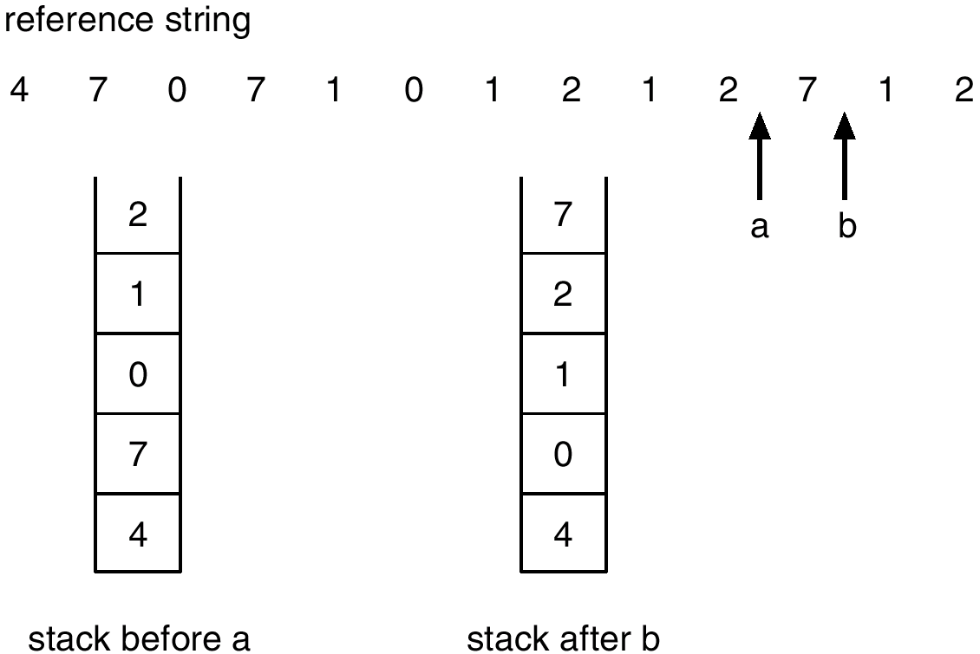
Use Of A Stack to Record The Most Recent Page References

Slide 104
LRU Approximation Algorithms
Reference bit
  With each page associate a bit, initially = 0
  When page is referenced bit set to 1.
  Replace the one which is 0 (if one exists). We do not know the order, however.
Second chance
  Need reference bit.
  Clock replacement.
  If page to be replaced (in clock order) has reference bit = 1. then:
    set reference bit 0.
    leave page in memory.
    replace next page (in clock order), subject to same rules.

Slide 105

Second-Chance (clock) Page-Replacement Algorithm

Slide 106
Enhanced Second-Chance Algorithm
We can enhance the second-chance algorithm by considering the reference bit and the modify bit :
1. (0, 0) neither recently used nor modified—best page to replace
2. (0, 1) not recently used but modified—not quite as good, because the page will need to be written out before replacement.
3. (1, 0) recently used but clean—probably will be used again soon
4. (1, 1) recently used and modified—probably will be used again soon, and the page will be need to be written out to disk before it can be replaced

Slide 107
Counting Algorithms
Keep a counter of the number of references that have been made to each page.
LFU Algorithm: replaces page with smallest count.
MFU Algorithm: based on the argument that the page with the smallest count was probably just brought in and has yet to be used.

Slide 108
Global vs. Local Allocation
Global replacement – process selects a replacement frame from the set of all frames; one process can take a frame from another.
Local replacement – each process selects from only its own set of allocated frames.

Slide 109
Thrashing
If a process does not have “enough” pages, the page-fault rate is very high. This leads to:
  low CPU utilization.
  operating system thinks that it needs to increase the degree of multiprogramming.
  another process added to the system.
Thrashing ≡ a process is busy swapping pages in and out.

Slide 110
Working-Set Model
Δ ≡ working-set window ≡ a fixed number of page references
Example: 10,000 instruction
WSS_{i} (working set of Process P_{i}) =
total number of pages referenced in the most recent Δ (varies in time)
  if Δ too small will not encompass entire locality.
  if Δ too large will encompass several localities.
  if Δ = ∞ ⇒ will encompass entire program.
D = Σ WSS_{i} ≡ total demand frames
if D > m (total available frames)⇒ Thrashing
Policy if D > m, then suspend one of the processes.

Slide 111

Working-set model

Slide 112

Page-Fault Frequency Scheme
Establish “acceptable” page-fault rate.
  If actual rate too low, process loses frame.
  If actual rate too high, process gains frame.

Slide 113
Other Considerations
Prepaging
Page size selection

Slide 114
Page Size
Smaller page size, less amount of internal fragmentation
Smaller page size, more pages required per process
More pages per process means larger page tables
Larger page tables means large portion of page tables in virtual memory
Secondary memory is designed to efficiently transfer large blocks of data so a large page size is better

Slide 115
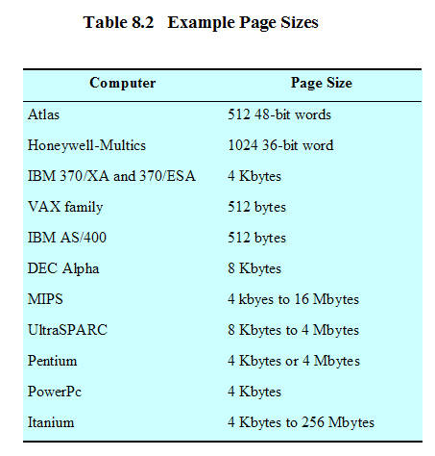
Example Page Sizes

Slide 116
In the given problem (decimal values), a page size of 5000 bytes, and the following page table
Which of the following virtual addresses would generate a page fault? For those that do not generate a page fault, to what physical address would they translate? a) 21610 b) 35410 c) 27012 d) 10234
index | In /out | frame
0 | out | 333
1 | in | 300
2 | in | 1000
3 | out | 100
4 | out | 500
5 | in | 120
6 | out | 412
7 | in | 740

